Slide 1
Ligo concept in Virtual Reality
With Leap Motion Sensor
By
Aishwariya.R

Slide 2
What is Leap motion sensor?
a computer hardware sensor device that supports hand and finger motions as input analogous to a mouse, but requires no hand contact or touching.
Reach into virtual reality with your bare hands.

Slide 3
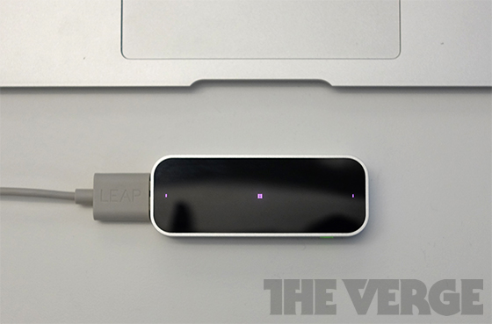
Leap motion sensor

Slide 4
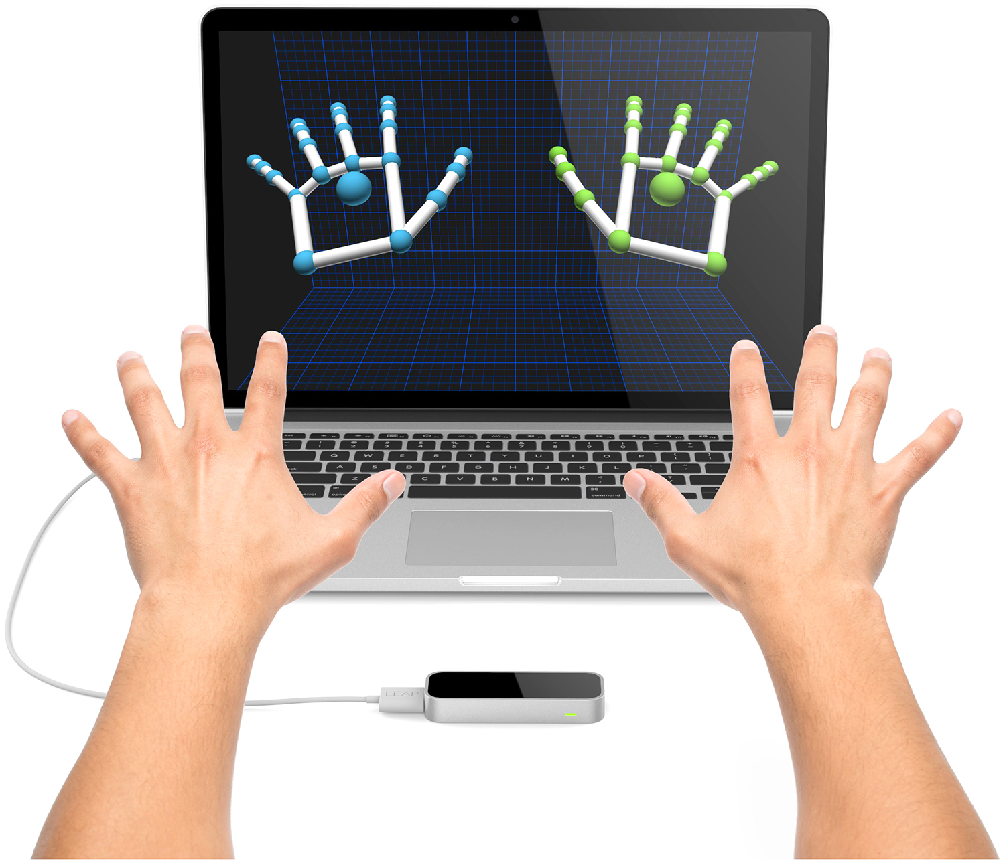
How does the Leap WORK?
Can track movements down to a 1/100th of a millimeter
It’s 200x more sensitive than existing touch-free products & technologies
The Leap senses hand and finger movements independently, as well as items
Notes:
The Leap is so precise that it can track movements down to 1/100th of a millimeter. This means that it is 200 times more sensitive than existing touch-free products and technologies such as the Kinect, which can sense motion and movement in a larger whole. The precision of this device can tell the difference between each finger and knows which is which, and it can sense the difference between a hand and a pencil.

Slide 6
Features
iPod sized USB peripheral
Creates a 3D interaction space of 8 cubic feet to precisely control software on a computer
Distinguishes thumbs from fingers to pencils
Can create custom gestures
Network more than one Leap device

Slide 7
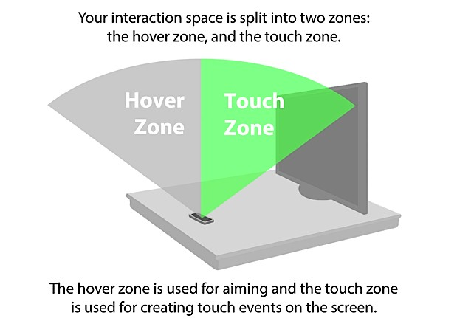

Slide 8
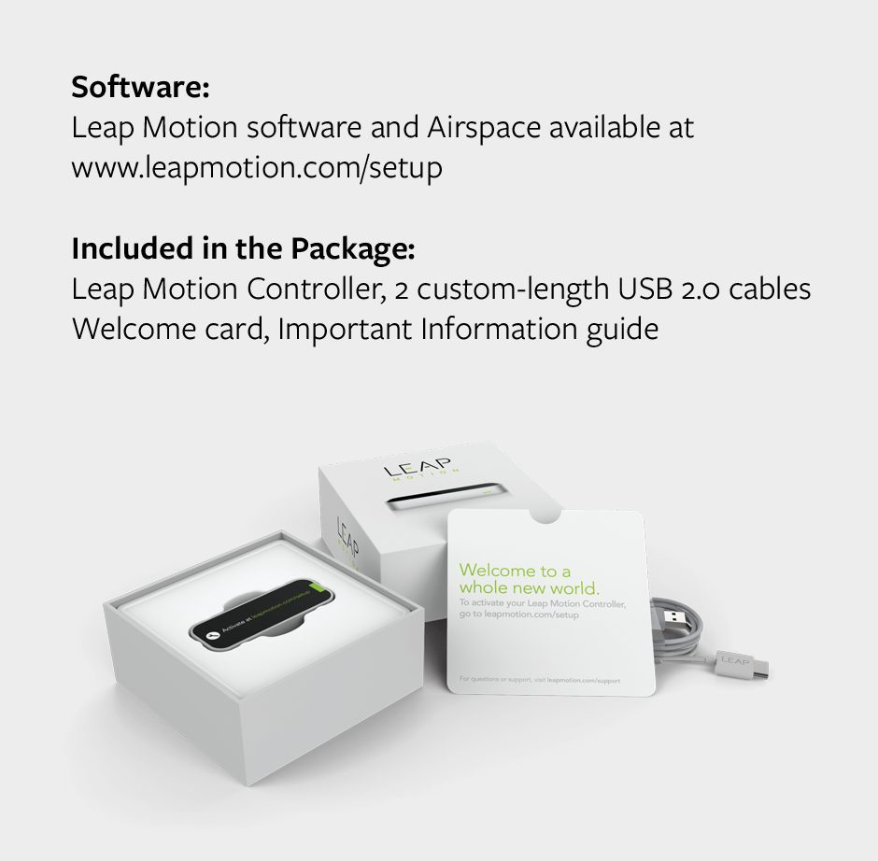

Slide 9
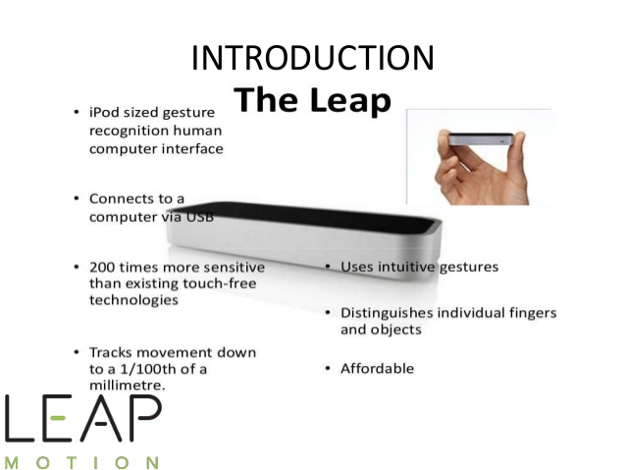

Slide 10
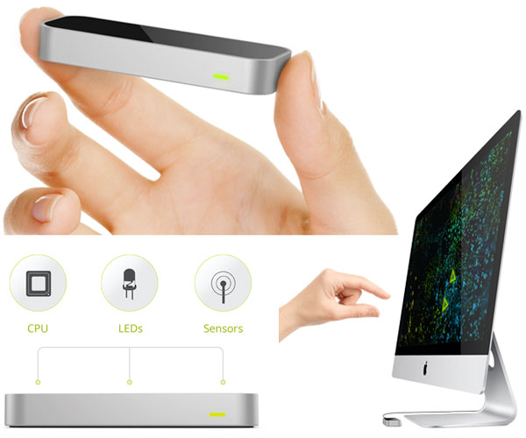

Slide 11
MOTIONS
Translate
Rotate
Scale
GESTURES
Circle
Swipe
Tap

Slide 12
How It Will Impact The World
Artists and creative types can use The Leap to emulate a stylus or easily create 3D img.
Anyone can use The Leap to interact with Windows 7/8 or Mac OS X by clicking, grabbing, scrolling and using familiar gestures like pinch to zoom in 3D space.
Engineers can interact more easily with 3D modeling software.
Gamers can play more easily and many will modify with Leap in mind.
Surgeons can control 3D medical data with their hands without taking off their gloves.
Notes:
There are so many different ways that Leap Motion can be used that it has obvious potential to impact the world. Artists and creative types can use The Leap to emulate a stylus or easily create 3D img. Anyone can use The Leap to interact with Windows 7/8 or Mac OS X by clicking, grabbing, scrolling and using familiar gestures like pinch to zoom in 3D space. Users pointing a pen at the signature line of a document to sign it in space. Engineers can interact more easily with 3D modeling software.
Gamers can play more easily and many will modify with Leap in mind.
Surgeons can control 3D medical data with their hands without taking off their gloves.

Slide 13
Stories are how we make sense of the world. One of the most effective ways to draw a user into any experience you build is to provide a story.
We observe, we listen, we absorb.

